Slide 1
Diffusion Models
The essential idea, inspired by non-equilibrium statistical physics, is to systematically and slowly destroy structure in a data distribution through an iterative forward diffusion process. We then learn a reverse diffusion process that restores structure in data, yielding a highly flexible and tractable generative model of the data.

Slide 2
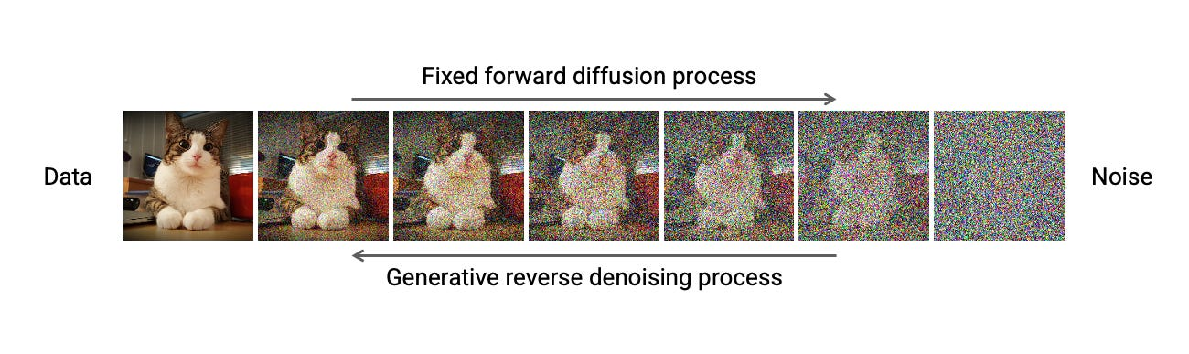

Slide 3
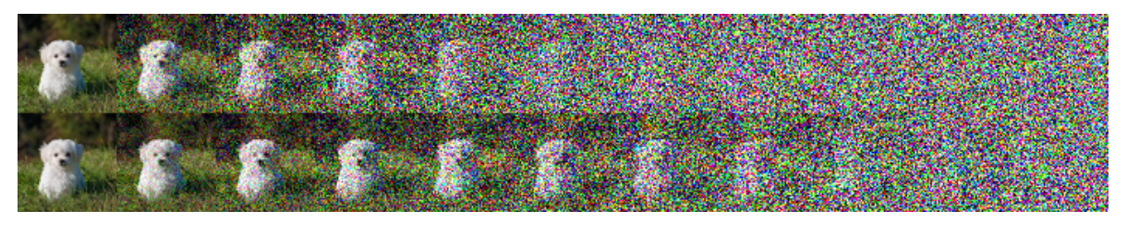
Linear vs Cosine Schedule

Slide 4
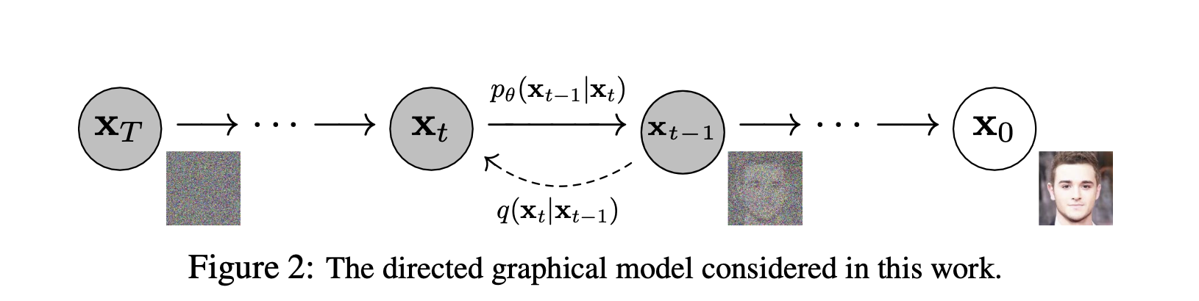

Slide 5
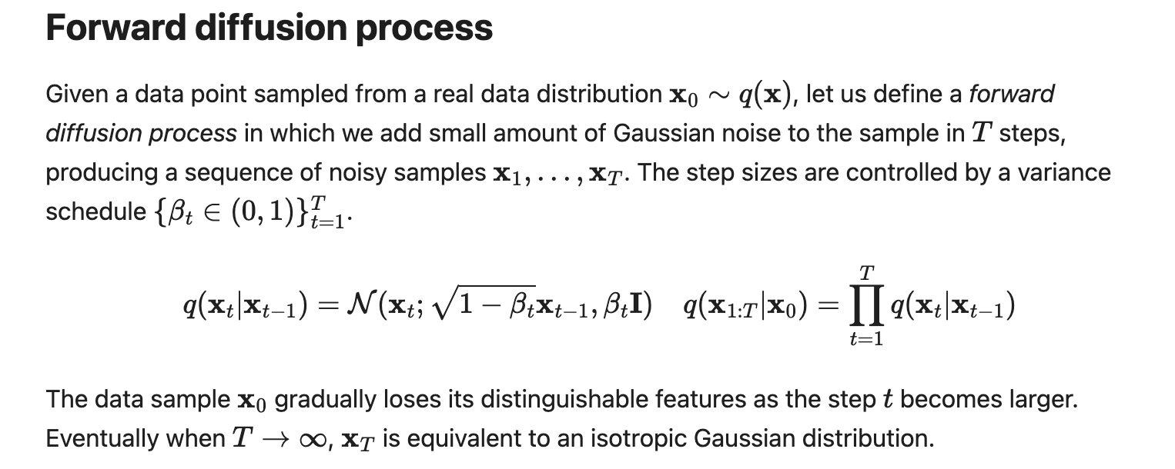

Slide 6
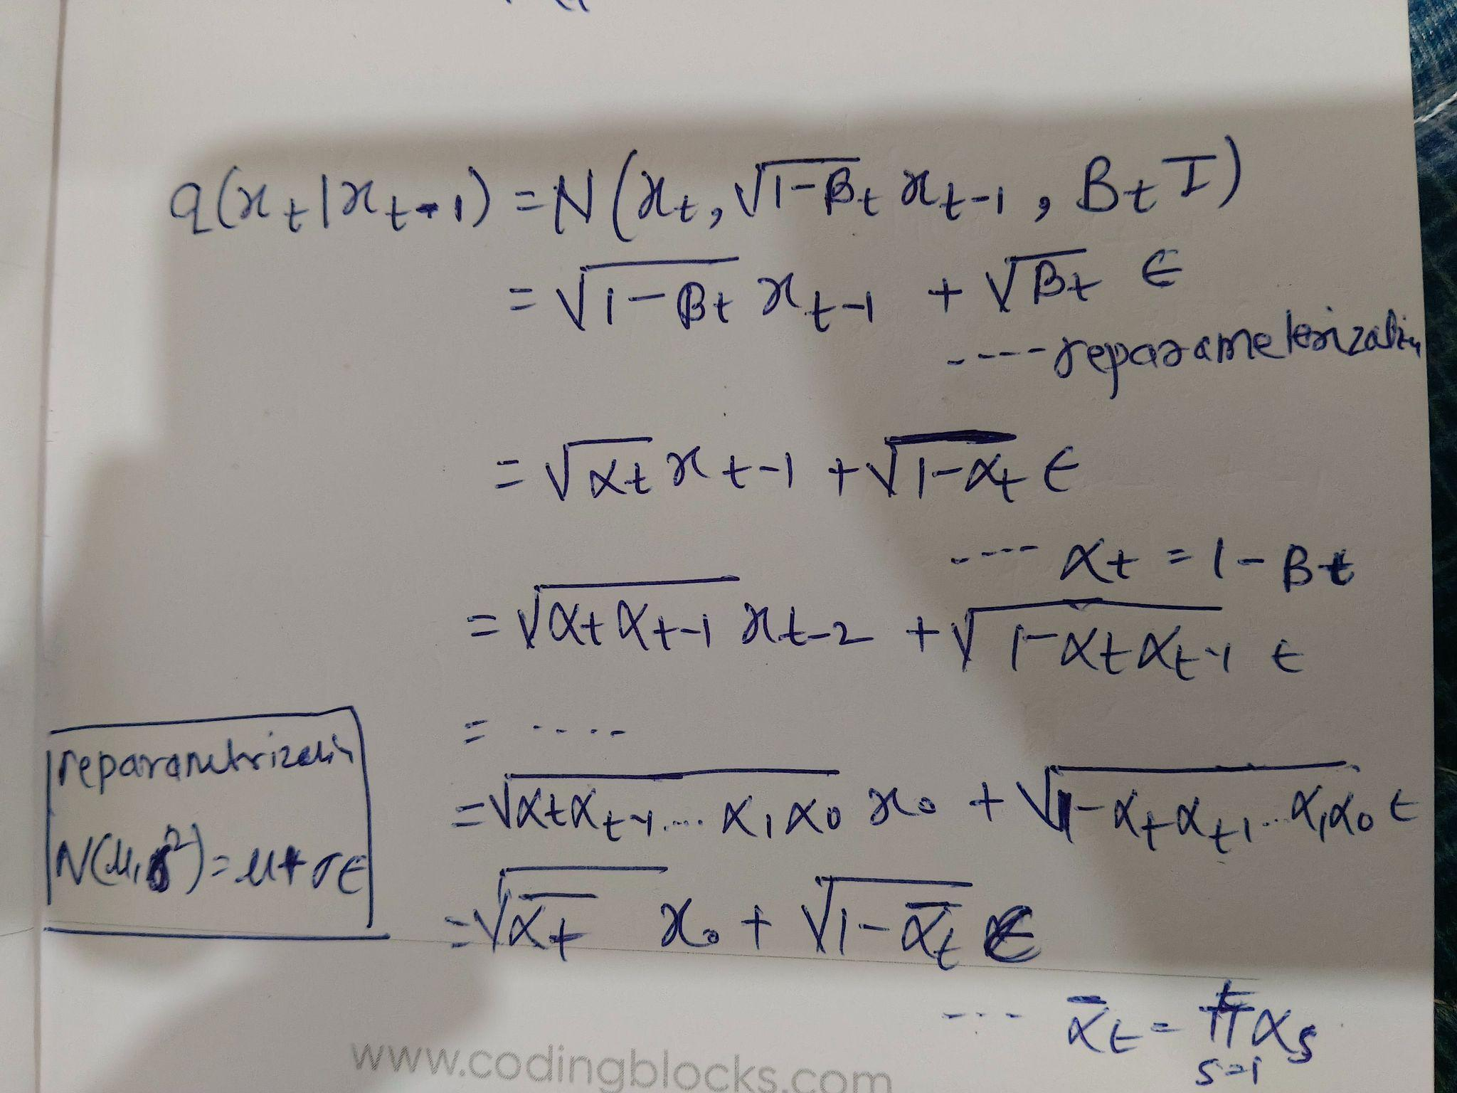

Slide 7


Slide 8
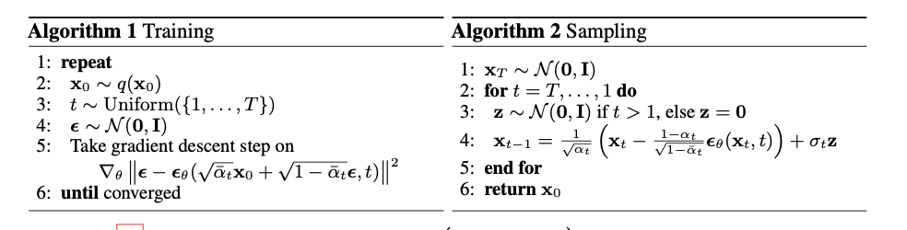

Slide 10
